Slide 1


Slide 2
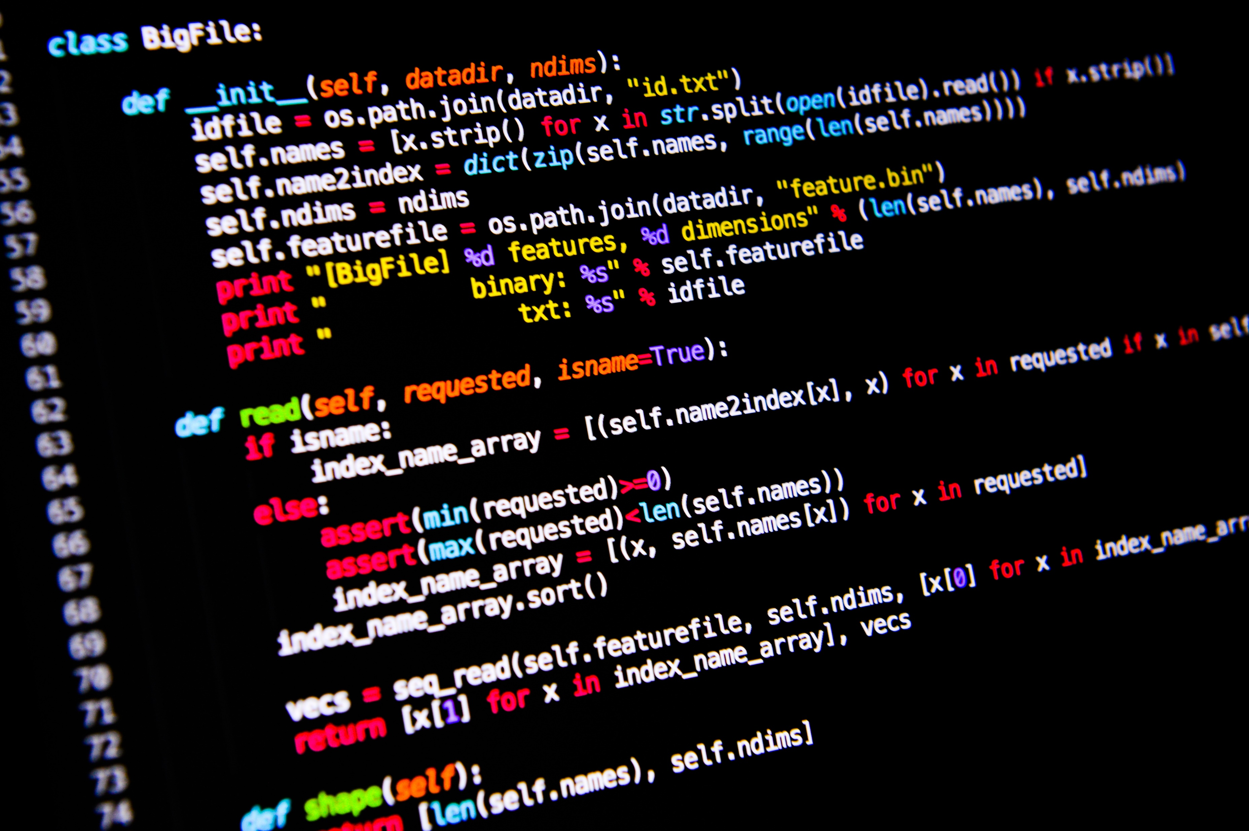

<Welcome To>
<WELCOME >

Slide 3

1.
Overall Program Content
Web development with Python | Hours
Work skills development | 50
Python Programming Introduction | 150
Web Programming Introduction (html/css) | 100
Databases Concepts and Structures | 50
Web Servers Programming | 150
Web services development | 150
Total | 650

Slide 4
Python programming Introduction Content
Course Introduction
Why Python?
Python Applications
Installation Tools
Building your code catalog
Useful websites

Slide 5
Python programming Introduction Content
Data types/outputs/inputs
Operators
Functions and Modules

Slide 6
Python programming Introduction Content
Conditional statements and expression
Loops
Work with standard Library and Modules

Slide 7
Python programming Introduction Content
Data structure in python
List
Tuple
Dictionaries
Set

Slide 8
Python programming Introduction Content
Files
Functions and Modules
Classes
Introduction to Numpy
Introduction to Pandas

Slide 9
Python programming Introduction Content
Introduction to matplotlib for data visualization
Data Preprocessing
100% Loaded

Slide 10
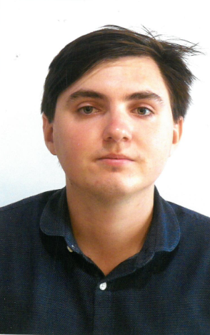
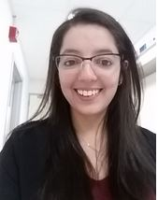
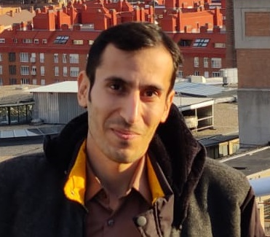
Our Professors::
Joseanne Viana (Josi)
Stefan Postolache
Hamed Farkhari
Email: jcova1@iscte-iul.pt
Email:stefanpostolache@edu.ulisboa.pt
Email:Hamed_Farkhari@iscte-iul.pt

Slide 11
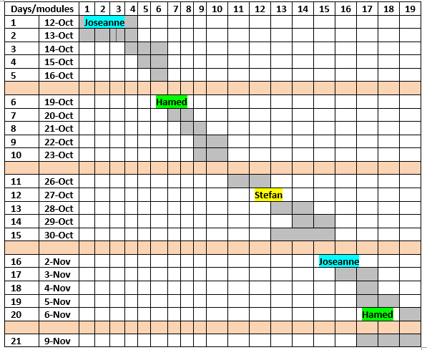
Schedule

Slide 12
Evaluation
Exercises
Projects
1 week to submit using your repositories

Slide 13
<WELCOME >
<Let’s get started >

Slide 14
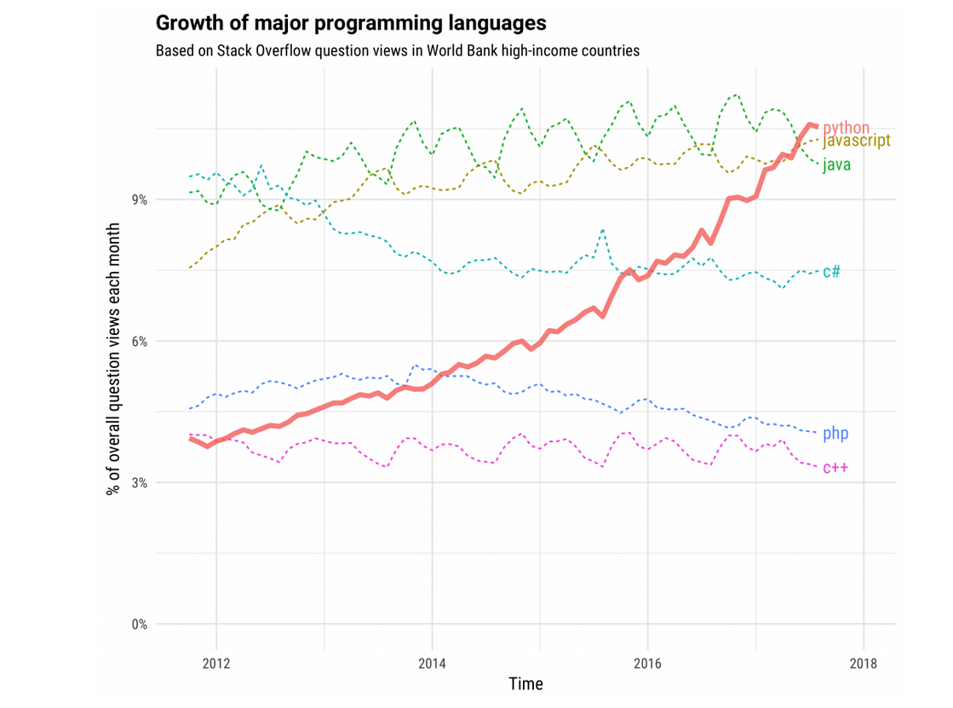
Why Python?
https://stackoverflow.blog/2017/09/06/incredible-growth-python/

Slide 15

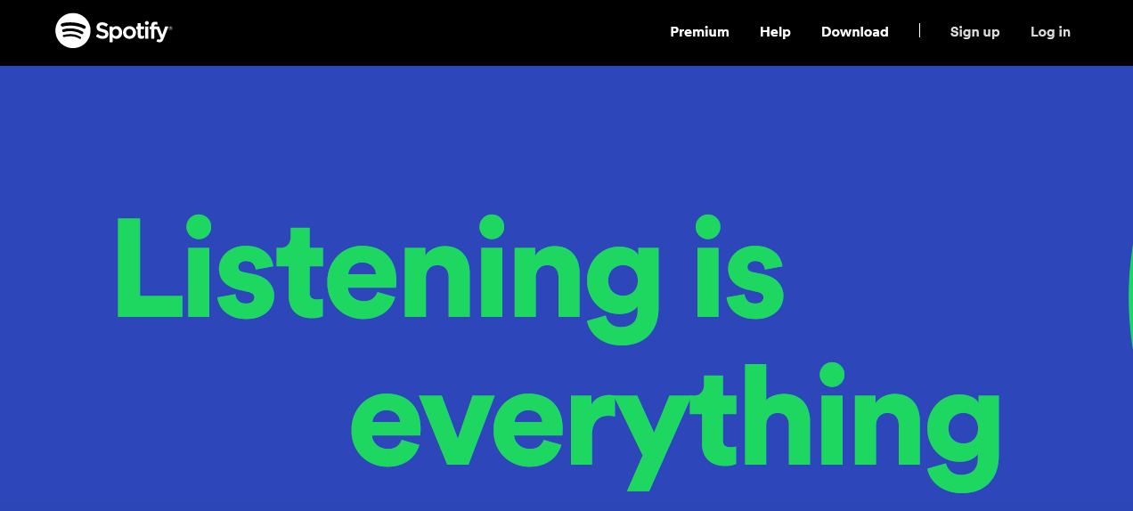
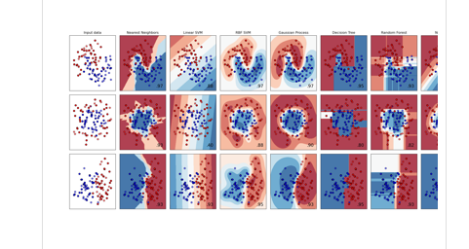
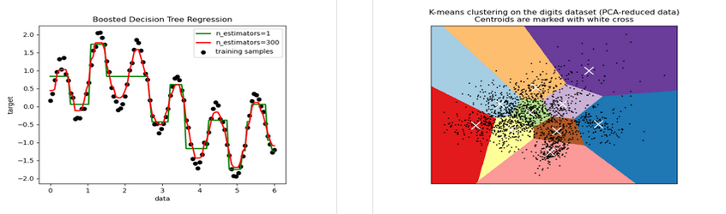
Python Applications
Spotify
Instagram
https://www.spotify.com/pt/
Machine learning development
https://scikit-learn.org/stable/index.html

Slide 16




Programming tools
https://www.spyder-ide.org/
Programming Tools -IDEs
Atom
https://atom.io/
PyCharm
https://www.jetbrains.com/pycharm/

Slide 17

Anaconda for Windows
Installation Tools
https://www.anaconda.com/

Slide 18

Products / Individual Edition

Slide 19
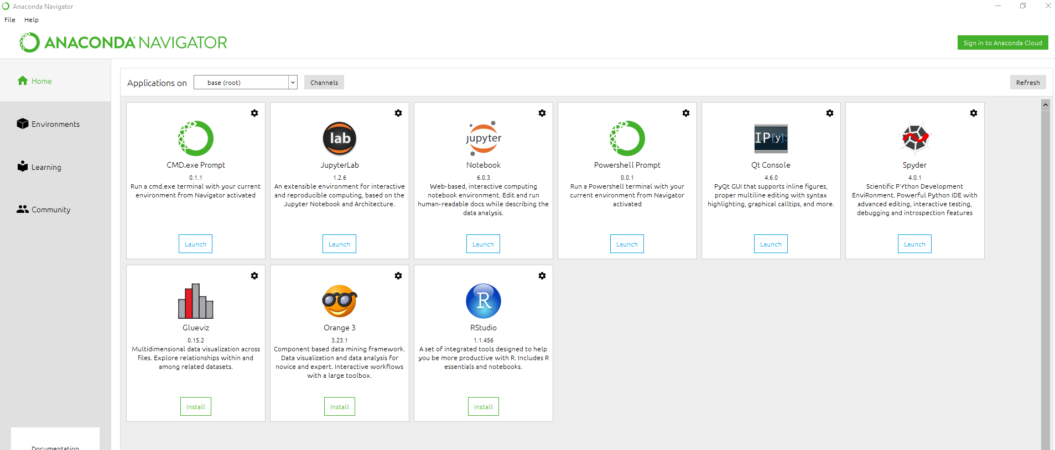

Slide 20
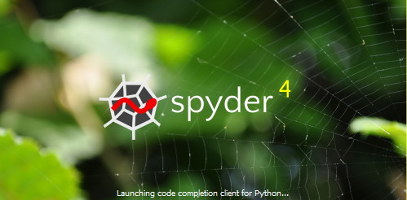

Slide 21
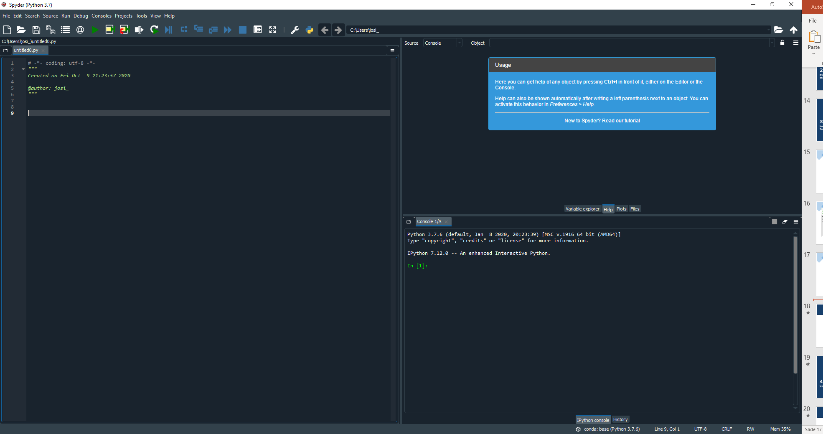

Slide 22
Editor

Slide 23
Console

Slide 24
Help
Variables explorer
Plots
Files
Console

Slide 25
Debugging
Variables explorer

Slide 26




Building your on Catalog

Slide 27
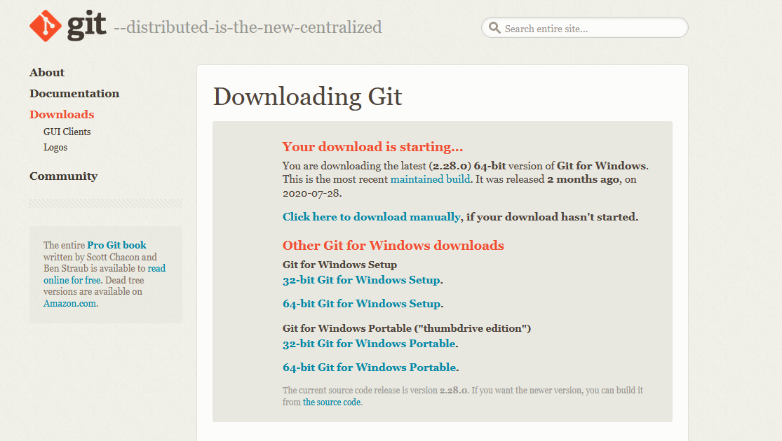
https://git-scm.com/downloads

Slide 28
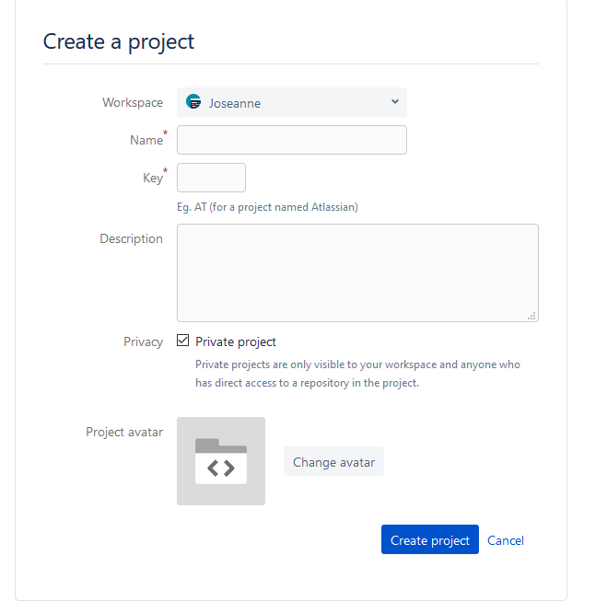
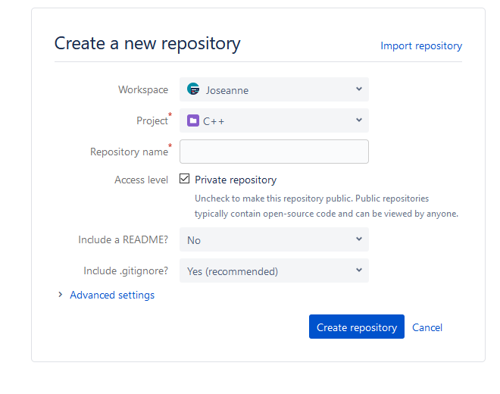
Create account bitbucket
Create a project
Create a new repository
Integration with BitBucket

Slide 29
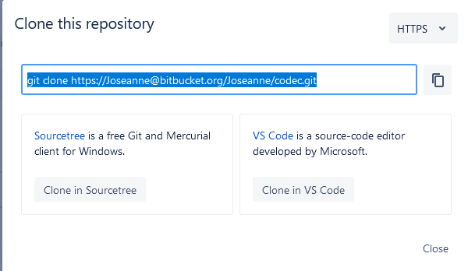
Copy

Slide 30


Slide 31
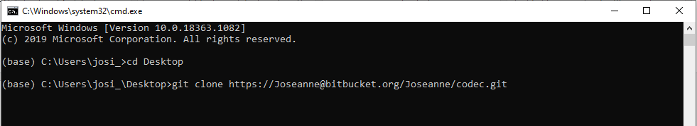
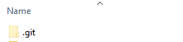
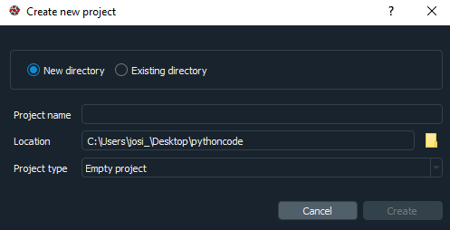
Open the folder created in the desktop and check the .git file
Go to Spyder and create a new project
Select the folder where the .git folder is located

Slide 32
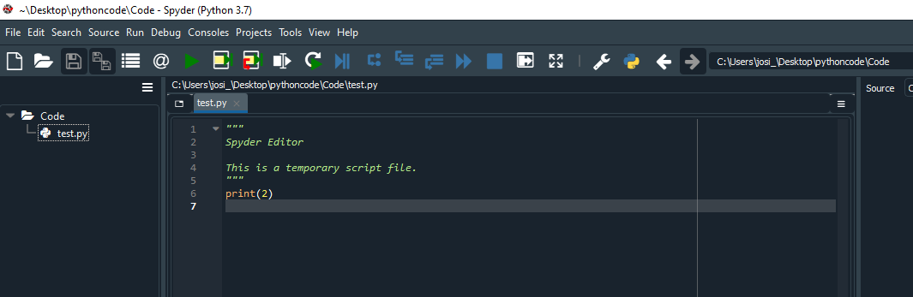
Create a file test.py

Slide 34
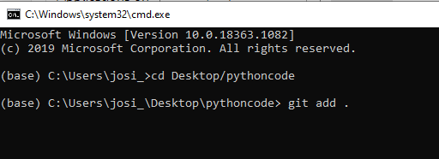
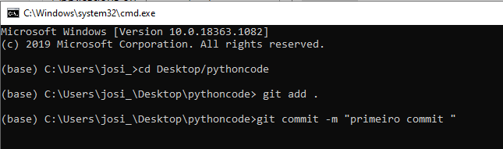
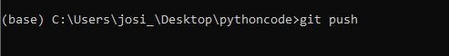

Slide 35
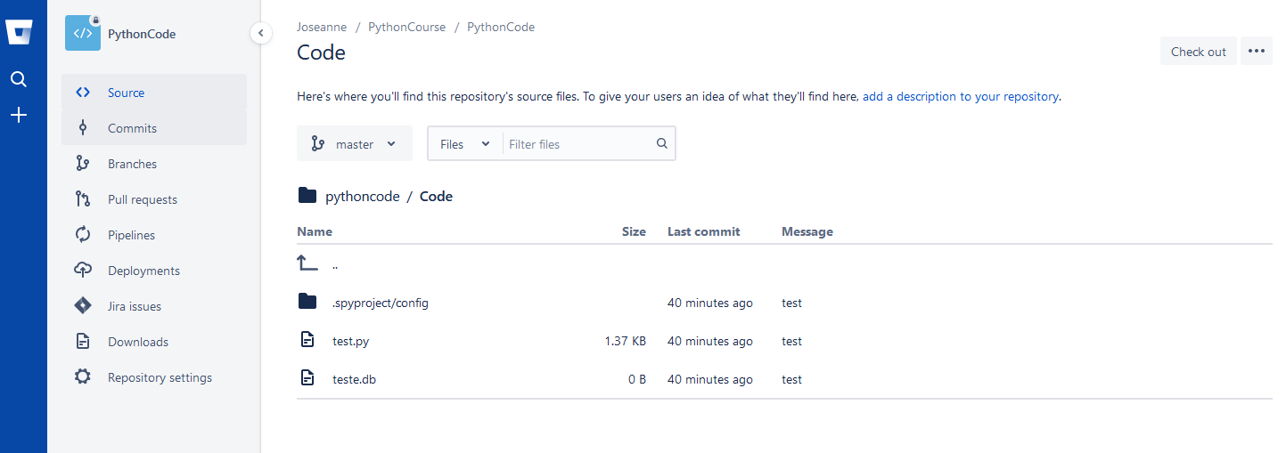
https://bitbucket.org/ <your repository>

Slide 36

<Coffee Time>

Slide 37
You can only solve the problems quickly if you’ve already solved the problem/ seen the problem solved before.

Slide 38
<WELCOME >
<Let’s make some code>

Slide 39
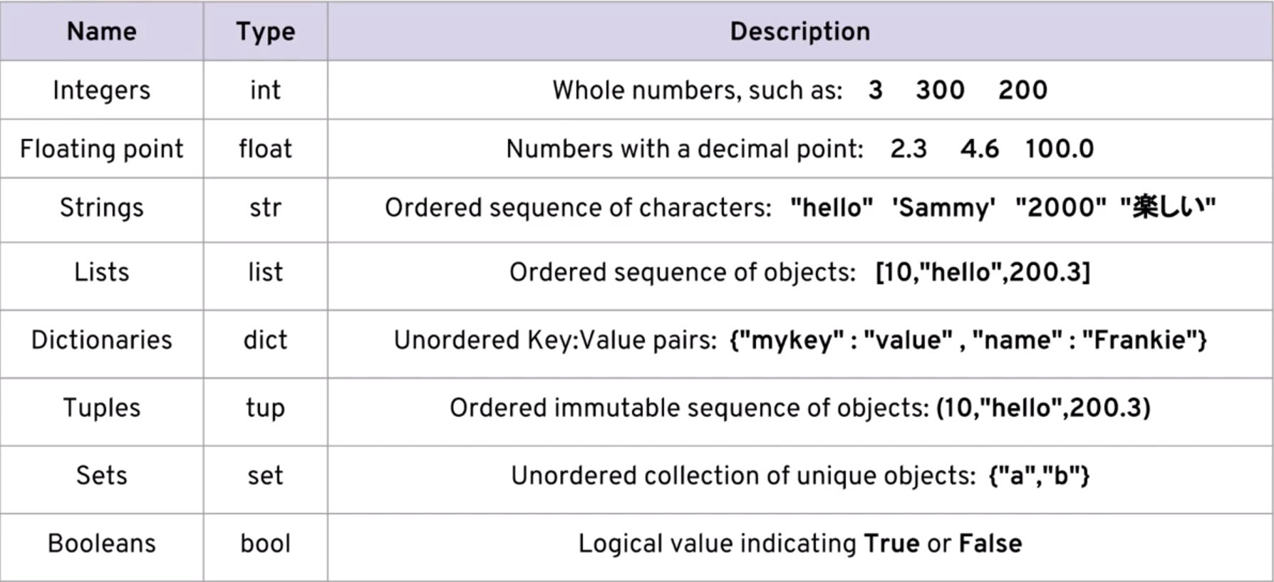
Basic datatypes

Slide 40
<WELCOME >
<Exercise - 1>

Slide 41
Exercise 1
Outputs commands:
print() #It is a function
Write a code to print out the string “Welcome to python course”
Expected Output:
Welcome to python course
print(“Welcome to python course”)
print (‘Welcome to pythonCourse’)
Function
Argument

Slide 42
Exercise 1
b. Write a code to print out the result of the operations 8+5*13
Expected Output:
73
print(8+5*13)
c. Write a code to print out <Python is fun> <number of the days of this month >
Expected Output:
Python is fun 31
print(“Python is fun”, 31)

Slide 43
Concatenating strings
Creating variables to store values
Splitting lines \n
and using tabs \t
print(“Hello” + “<Your name >”)
print(“Hello”‘ ’“<Your name>”)
print("Hello" + "<Your name>\n You are splitting this line several\ntimes\n")
print(“Hello, <Your name>”)
Greeting = “Hello”
name = <Your name>
print(greeting + name)
print(greeting +’ ’+ name)
print(type(name))
age = 1
print( name + age)

Slide 44
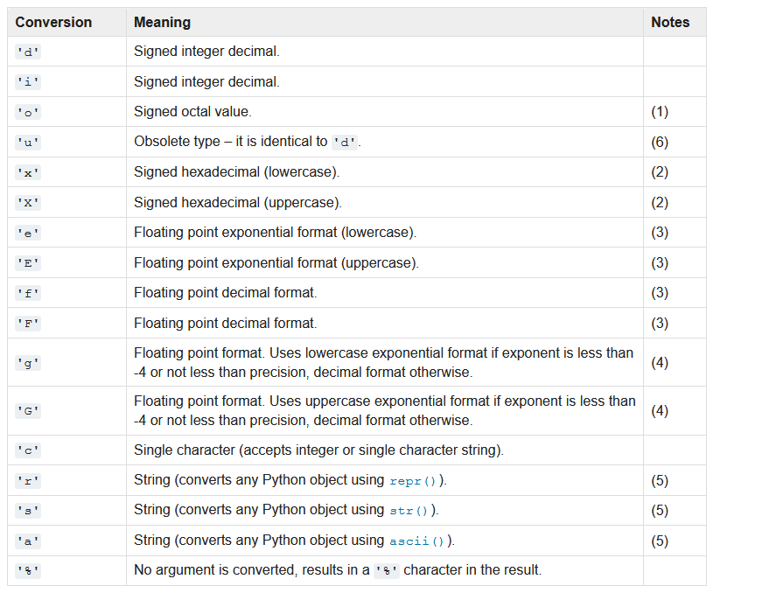
String Formatting -old fashion %

Slide 45
Strings Formatting –f-Strings
name =“Josi”
age = 31
print('%s is %d years old' % (name, age))
print('{} is {} years old'.format(name, age))
print(f'{name} is {age} years old')

Slide 46
<WELCOME >
<Exercise - 2>

Slide 47
Exercise 2
Write a code to produce the following output
Expected Output:
Student 1 <You Name>
Student 2 <Student sitting in your side>
print(“Student 1\t<Name>")
print(“Student 2\t<Name>")
Display float number with 2 decimal places using print()
Expected Output:
458.541315 as 458.54
print('%.2f' % 458.541315)

Slide 48
<WELCOME >
<Exercises – 3-5 >

Slide 49
Exercise 3
input commands:
input() #It is a function
Write a code to ask for a name, store it in a variable and print it
Expected input: <Your name>
Expected output <Your name>
print(“Please, Enter your name:”)
student_name = input()
print(student_name)

Slide 50
Exercise 4
https://docs.python.org/2.5/lib/string-methods.html
input commands:
Write a code that receives your name as
Input: john Anna Joe
Expected output:
John
Anna
Joe
Guide: use split() method for strings

Slide 51
Exercise 4 – Solution
str1, str2, str3 = input("Enter three string").split()
print(str1, str2, str3)

Slide 52
Exercise 5
You have the following data.
totalMoney = 1000
quantity = 3
price = 450
display above data using string.format() method
expected output:
I have 1000 dollars so I can buy 3 football for 450.00 dollars.

Slide 53
Exercise 5 – Solution
quantity = 3
totalMoney = 1000
price = 450
statement1 = "I have {1} dollars so I can buy {0} football for {2:.2f} dollars."print(statement1.format(quantity, totalMoney, price))

Slide 54
<WELCOME >
<Exercise – 6-7 >

Slide 55
Exercise 6
#msg = 012345678901234
#letters = "abcdefghijklmnopqrstuvwxyz"
msg = “Lisbon is in Portugal“ #23 letters
print(msg[1])
print(msg[0:6]) #Lisbon
print(msg[3:5])
print(msg[0:9])
print(msg[:9])
print(msg[10:14])
print(msg[10:])
print(msg[:6])
print(msg[6:])
print(msg[:6] + msg[6:])
print(msg[:])
Splitting Strings

Slide 56
Exercise 7
#msg = 012345678901234
#letters = "abcdefghijklmnopqrstuvwxyz"
msg = "Lisbon is in Portugal" #23 lettters
print(msg[-21:-15]) #Lisbon
print(msg[-8:-5])
print(msg[-14:-12])
print(msg[-8:])
print(msg[-11:-8])
print(msg[-23:])
print(msg[-5:-1])
print(msg[7:])
print(msg[:])
Splitting Strings

Slide 57
<WELCOME >
<Exercise - 8>

Slide 58
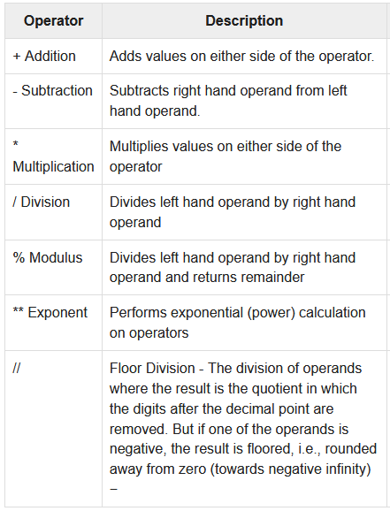
Arithmetic Operations

Slide 59
Exercise 8
a = 12
b = 3
print(a + b) # 15
print(a - b) # 9
print(a * b) # 36
print(a / b) # 4.0
print(a // b) # 4 integer division, rounded down towards minus infinity
print(a % b) # 0 modulo: the remainder after integer division
print()

Slide 60
<WELCOME >
<Exercise 9 - 10>

Slide 61
Exercise 9
Write a code that take two numbers from user, print the sum
Input1: <number>
Input2:<number>
Expected output: <number> +<number>

Slide 62
Exercise 9 –Solution
num1 = int(input(" Enter first number :"))
num2 =int(input(" Enter second number :"))
sum = num1 + num2
print(str(num1) + " + " + str(num2) + " = " , sum

Slide 63
Exercise 10
Write a code that get 5555
Input1: “xxxx----xxxx----5555---"
Expected output: 5555

Slide 64
Exercise 10 –Solution
credit_str = "xxxx----xxxx----5555---"
new_credit_str = credit_str[credit_str.index(‘5'):credit_str.index(‘5') + len(‘5555')]
print(new_credit_str)

Slide 65
Useful information
https://docs.python.org/3/library/sys.html
Import sys
print("\nInteger value information: ",sys.int_info)
print("\nMaximum size of an integer: ",sys.maxsize)

Slide 66
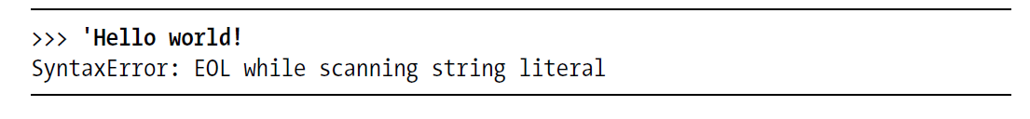
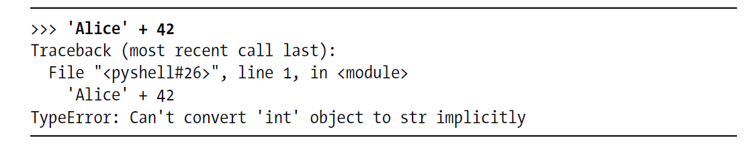
Identifying most common error messages

Slide 67
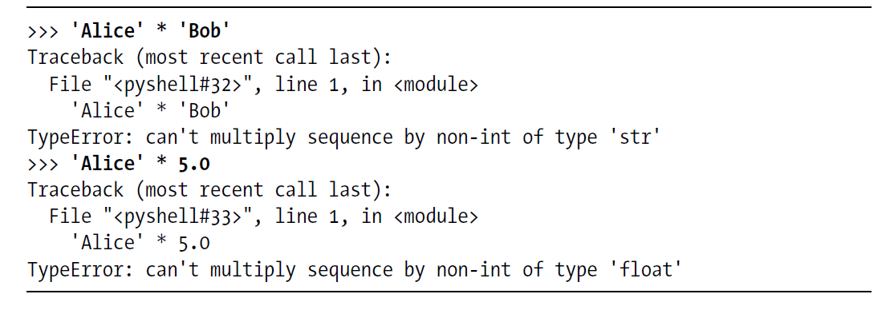

Slide 68
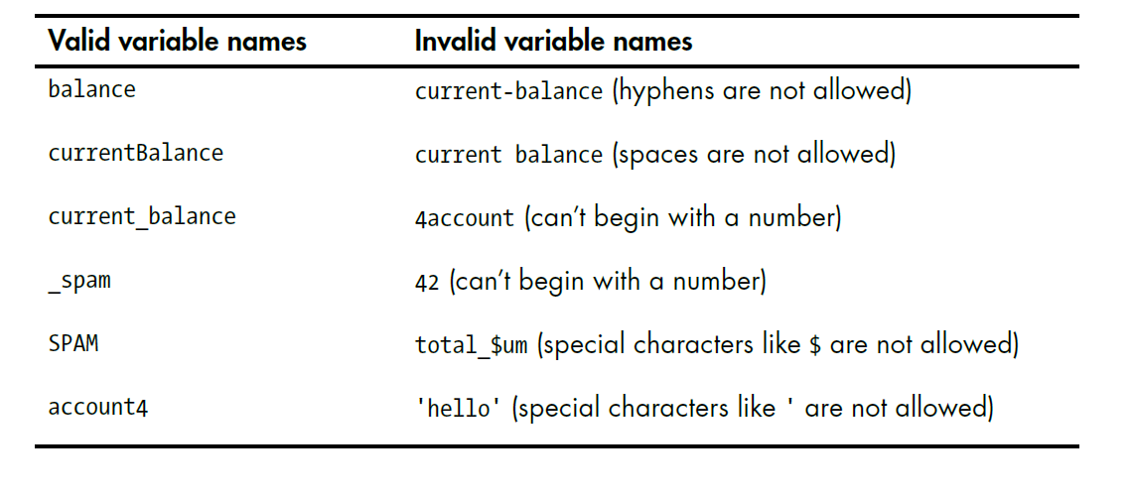

Slide 69
Recommended bibliography and teaching resources:
João Ventura, Full-speed Python, 2018. disponivel em http://joaoventura.net/blog/2018/full-speed-python/
AL Sweigart, Automate the boring stuff with python, San Francisco, 2015
Software:
Python programming language (https://www.python.org/ )
Spyder / Jupyter Notebook from Anaconda (https://www.anaconda.com/)
Data: https://data.oecd.org/portugal.htm , https://www.kaggle.com/datasets;

Slide 70
8.
Usefull links
https://www.anaconda.com/products/individual/get-started
https://www.python.org/
https://github.com/
https://git-scm.com/
https://about.gitlab.com/
https://bitbucket.org/dashboard/overview
https://stackoverflow.com/

Slide 71
Make it work
Make it Right
Make it Fast

Slide 72


